Slide 1
CSE 591: Data Science
Steven Skiena
Stony Brook University
Lecture 11: Principles of Visualizing Data

Slide 2
Exploratory Data Analysis
Looking carefully at your data is important:
to identify mistakes in collection/processing
to find violations of statistical assumptions
to observe patterns in the data
to make hypothesis.
Feeding unvisualized data to a machine learning algorithm is asking for trouble.

Slide 3
Tufte’s Visualization Aesthetic
Distinguishing good/bad visualizations requires a design aesthetic, and a vocabulary to talk about data representations:
Maximize data ink-ratio
Minimize lie factor
Minimize chartjunk
Use proper scales and clear labeling

Slide 4
Why Data Visualization?
Exploratory data analysis: what does your data really look like?
Error detection: did you do something stupid?
Presenting what you have learned to others.
A large fraction of the graphs and charts I see are terrible: visualization is harder than it looks.

Slide 5
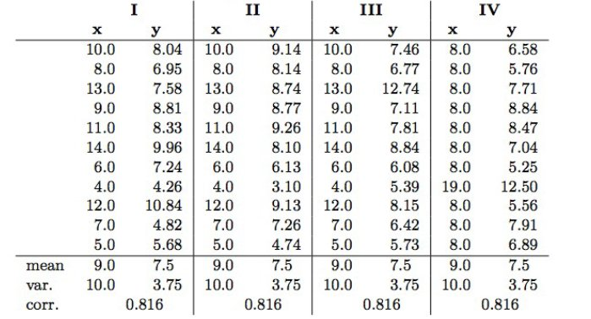
Ascombe’s Quartet
All four data sets have exactly the same mean, variance, correlation, and regression line:

Slide 6
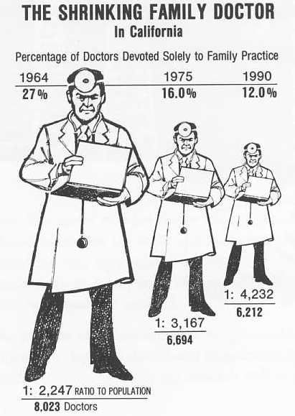
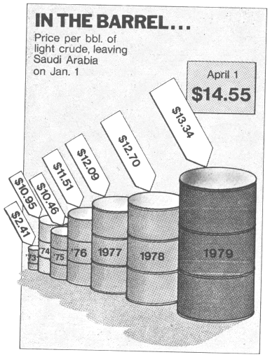
The Lie Factor: Dimensionality
(size of effect in graphic) / (size of effect in data)
The fixing a two- or three-dimensional representation by a single parameter yields a lie, because area or volume increase non-proportionally to length.

Slide 7
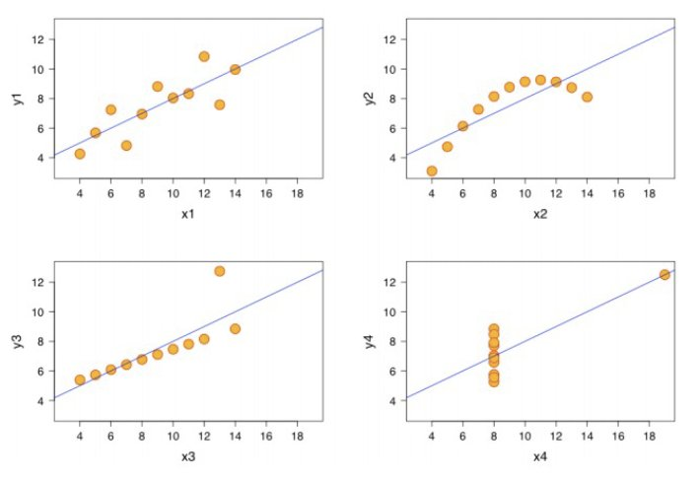
Plotting Ascombe’s Quartet

Slide 8
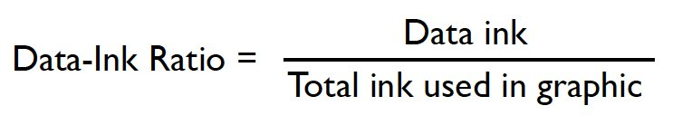
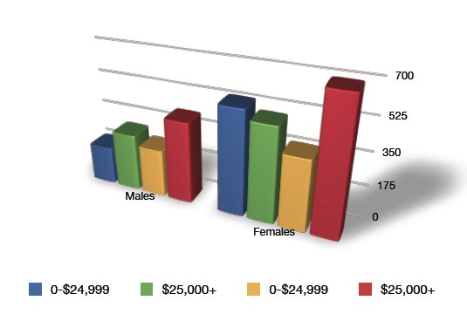
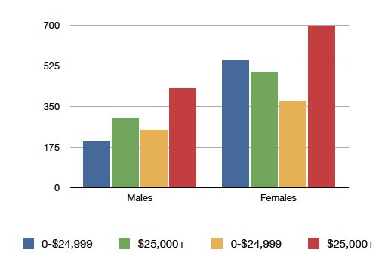
Maximize Data-Ink Ratio

Slide 9
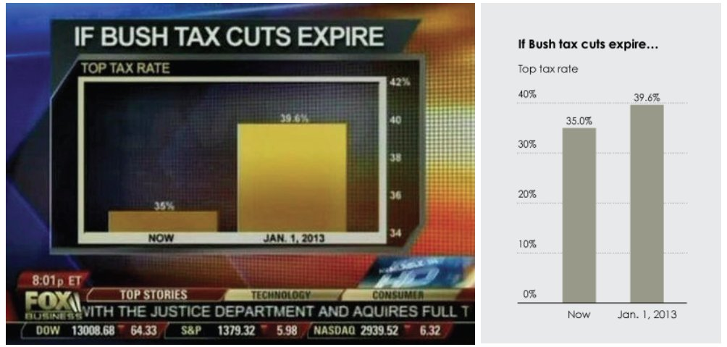
Graphical Integrity: Scale Distortion
Always start bar graphs at zero.
Always properly label your axes.
Use continuous scales: linear or labelled!

Slide 10
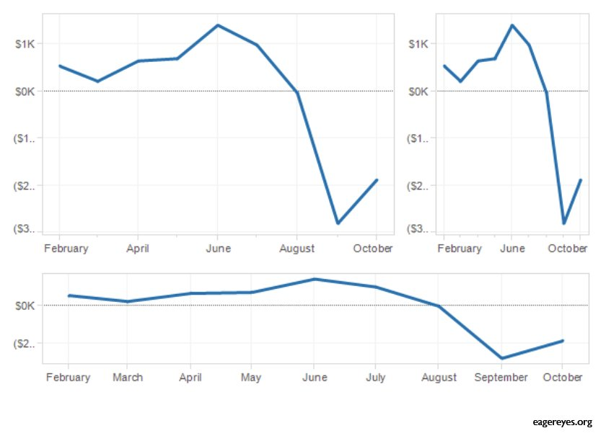
Aspect Ratios and Lie Factors
The steepness of apparent cliffs is a function of aspect ratio.
Aim for 45° lines or Golden ratio as most interpretable.

Slide 11
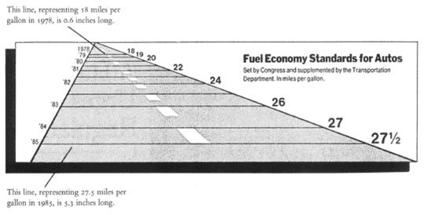
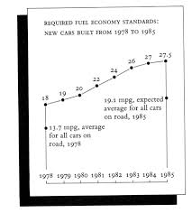
Can this be the Same Data?

Slide 12
Reduce Chartjunk
Extraneous visual elements distract from the message the data is trying to tell.
Extra dimensionality
Uninformative coloring
Excessive grids and figurative decoration
In an exciting graphic, the data tells the story, not the chartjunk.

Slide 13
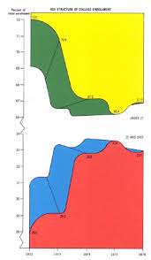
Chartjunk / Graphical Ducks

Slide 14
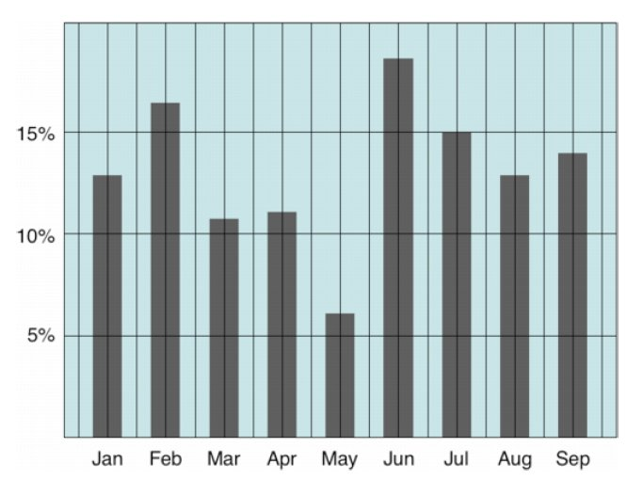
Can you Simplify this Plot?
Tim Brey
Notes:
From Harvard lecture 3, credited to Tim Brey

Slide 15
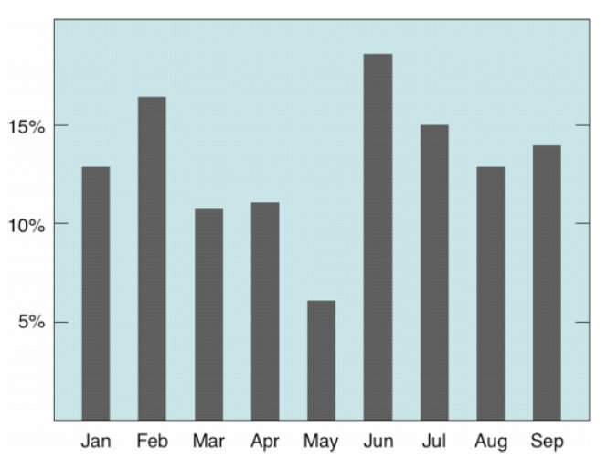
Can You Further Simplify?

Slide 16
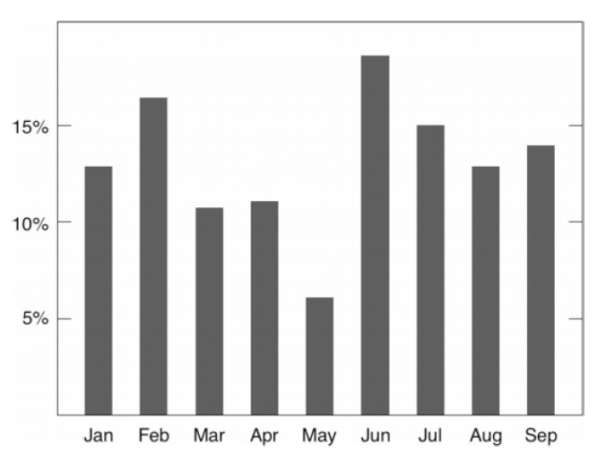
Better, but can you Further Simplify?

Slide 17
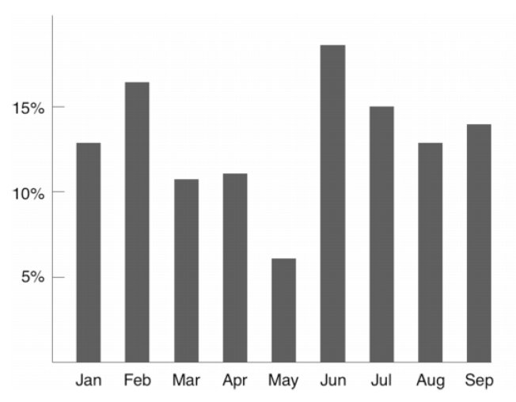
Anything Else that Can Go?

Slide 18
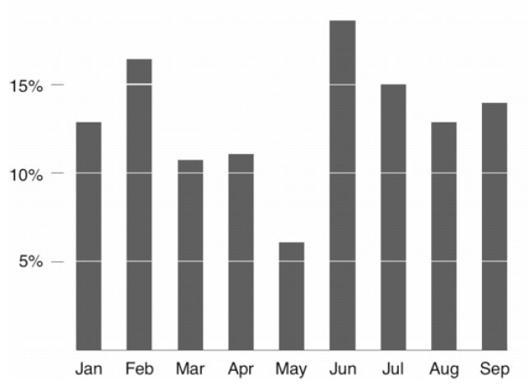
``Less is More’’

Slide 19
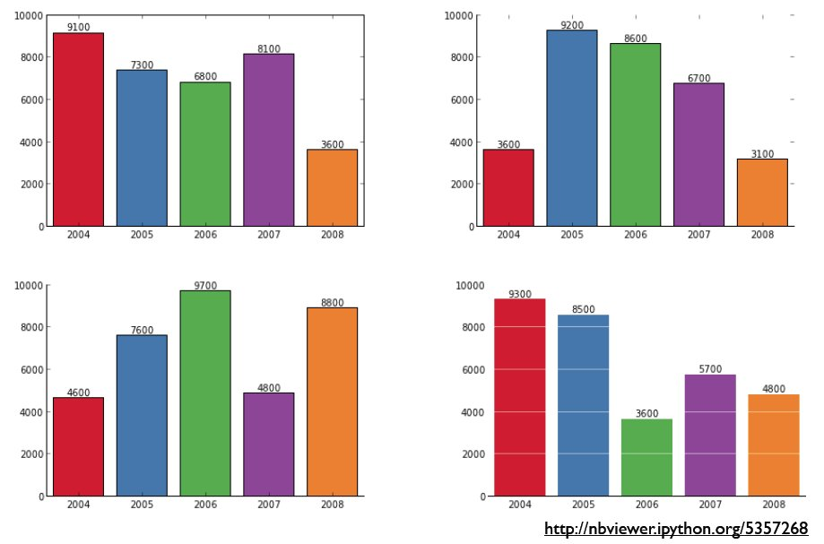
MatPlotLib Supports Nice Plots

Slide 20
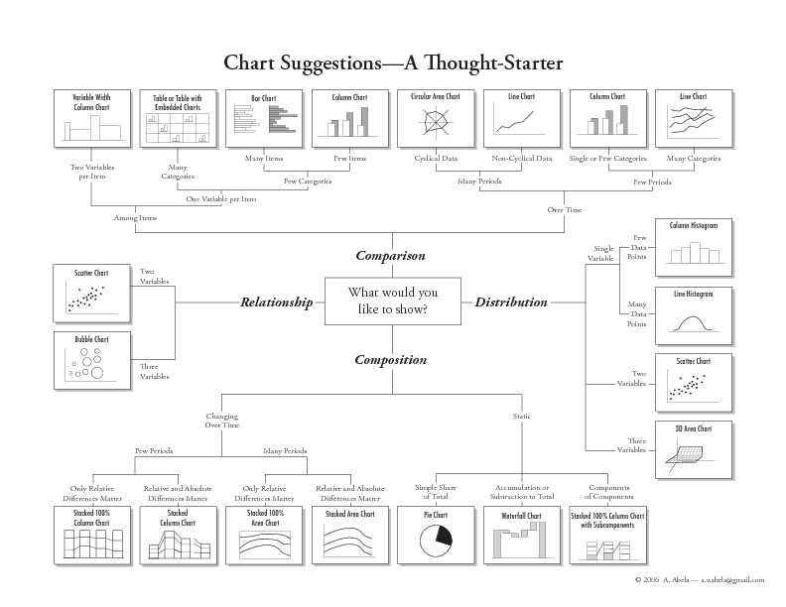
Which Chart to Use?

Slide 21
Tabular Data
Tables can have advantages over plots:
Representation of numerical precision
Understandable multivariate visualization: each column is a different dimension.
Representation of heterogeneous data
Compactness for small numbers of points.

Slide 22
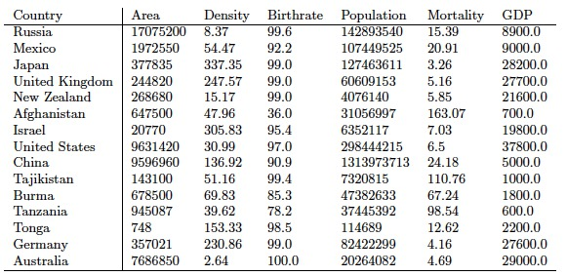
Can this Table be Improved?

Slide 23
Dimensions for Improvement
Order rows to invite comparisons.
Order columns to highlight importance or pairwise relationships.
Right justify uniform-precision numbers
Use emphasis, font, or color to highlight important entries.
Avoid excessive-length column descriptors.

Slide 24
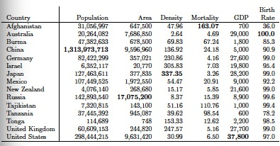
Improved Tabular Presentation

Slide 25
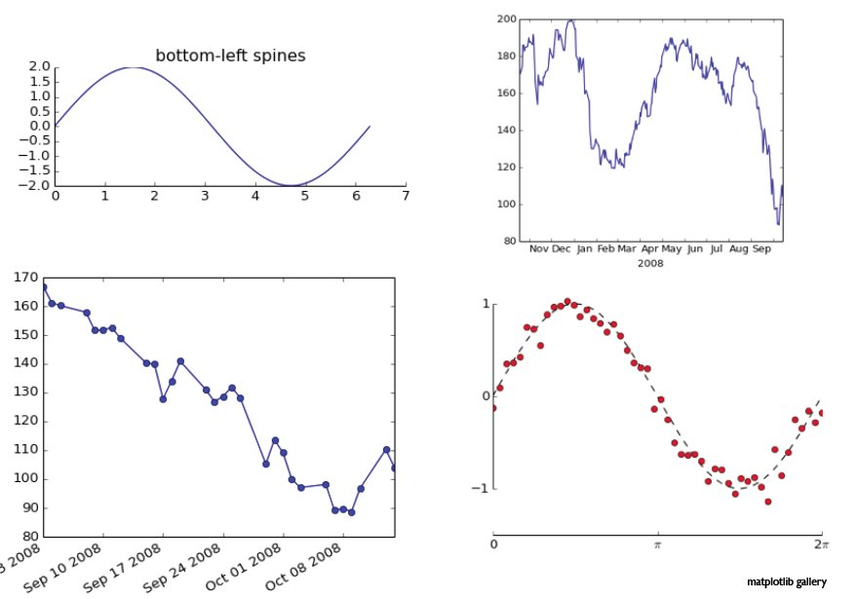
Line Charts
Show data points, not just fits.
Line segments show connections, so do not use in categorical data.
Connecting points by lines is often chartjunk. Better is usually a trend line or fit with the data points.

Slide 26
Scatter Plots / Multivariate Data
Scatter plots show the values of each point, and are a great way to present 2D data sets.
Higher dimensional datasets are often best projected to 2D, through self-organizing maps or principle component analysis, although can be represented through bubble plots.

Slide 27
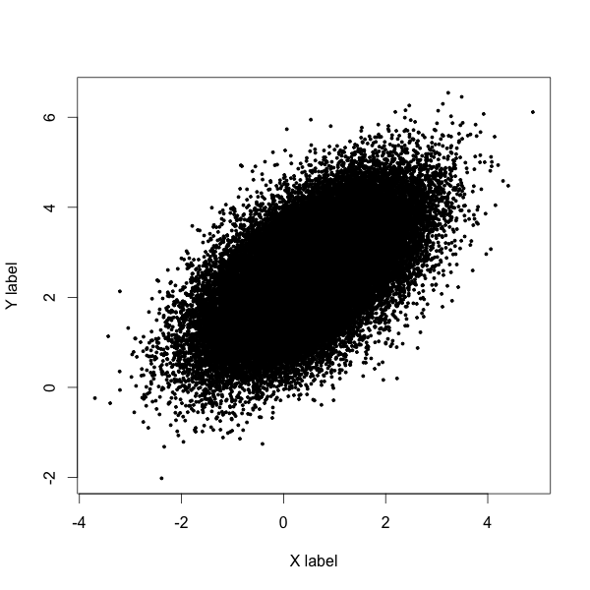
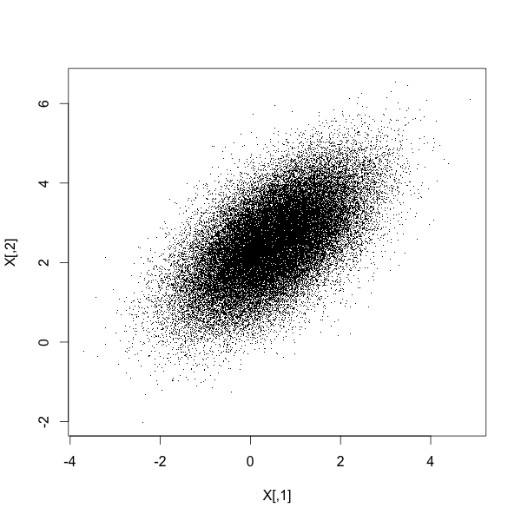
Reduce Overplotting by Small Points

Slide 28
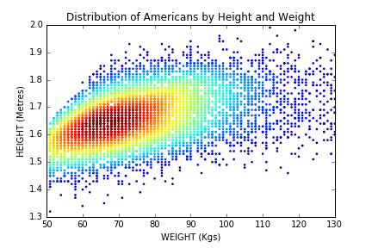
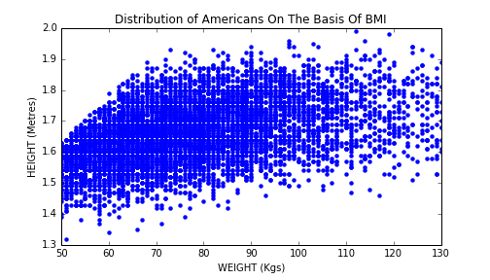
Heatmaps Reveal Finer Structure
Color points on the basis of frequency

Slide 29
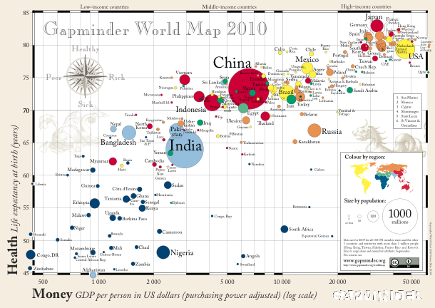
Bubble Charts for Extra Dimensions
Using color, shape, size, and shading of “dots” enables dot plots to represent additional dimensions.
https://www.youtube.com/watch?v=jbkSRLYSojo

Slide 30
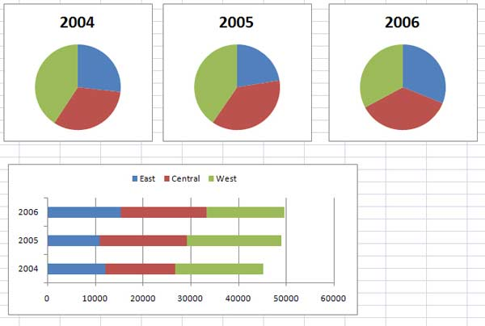
Bar Plots vs. Pie Charts
Bar plots show the frequency of proportion of categorical variables. Pie charts use more space and are harder to read and compare.
Partitioning each bar into pieces yields the stacked bar chart.
Pie charts are arguably better for showing percentages of totality, and people do seem to like them, so they may be harmless in small amounts.
Notes:
http://www.mrexcel.com/t15902.jpg

Slide 31
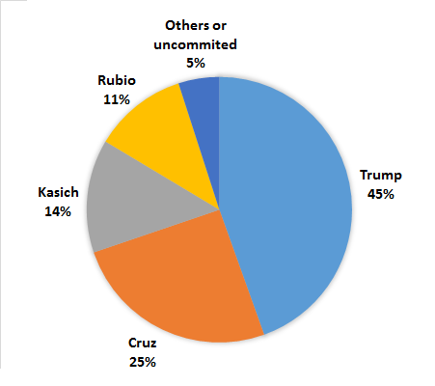
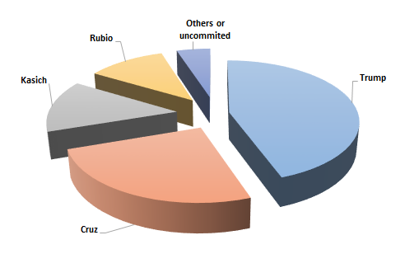
Which Pie Chart is Better?

Slide 32
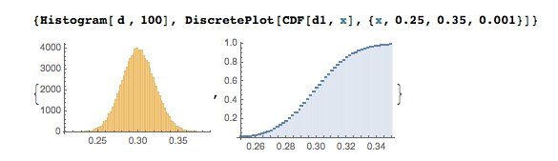
Histograms
Histograms (and CDFs) visualize distributions over continuous variables:
Histograms are better for displaying peaks, CDFs for showing tails.

Slide 33
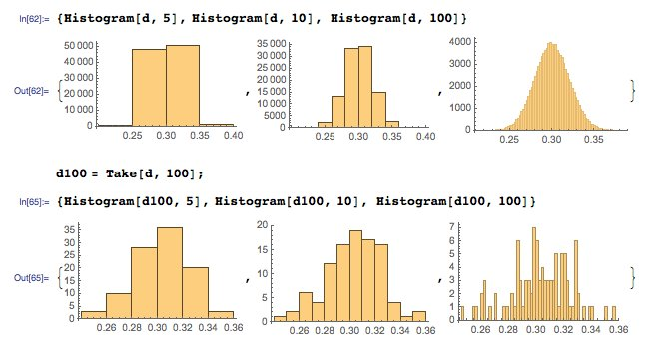
Histograms: Bin Size / Count Matters

Slide 34
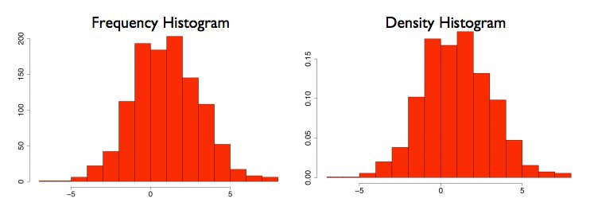
Frequency vs. Density Histograms
Dividing counts by the total yields a probability density plot, which is more interpretable:
Notes:
From http://www.gs.washington.edu/academics/courses/akey/56008/lecture/lecture2.pdf

